Slide 1
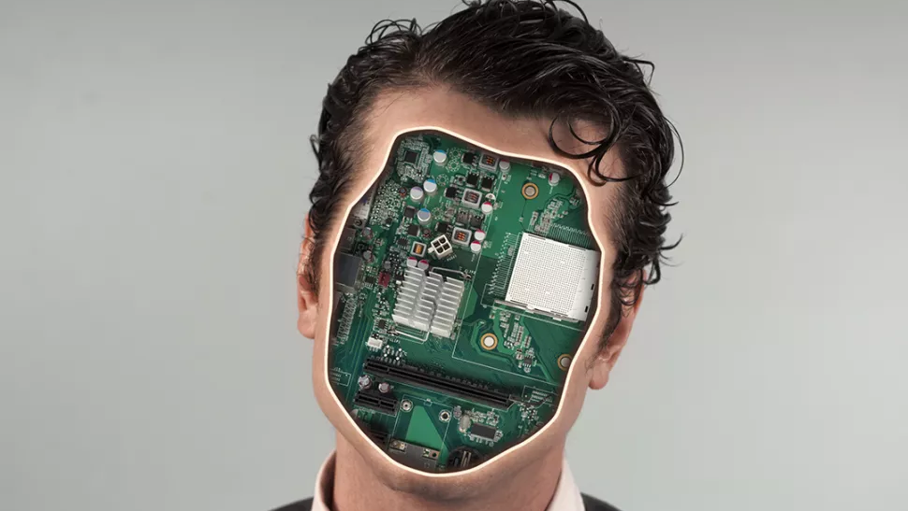
“Technology is a useful servant but a dangerous master.”
Creative Technology Semester 4
Maarten Hormes & Zonar Caldera

Slide 2

Vision
An environment that gives freedom and independence to people with severe disabilities or low mobility.

Slide 3
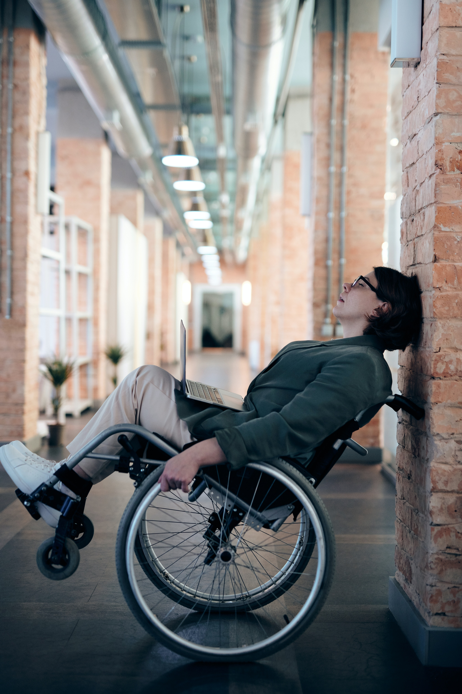
Tagline
Everyone deserves more
Freedom and independence.

Slide 4
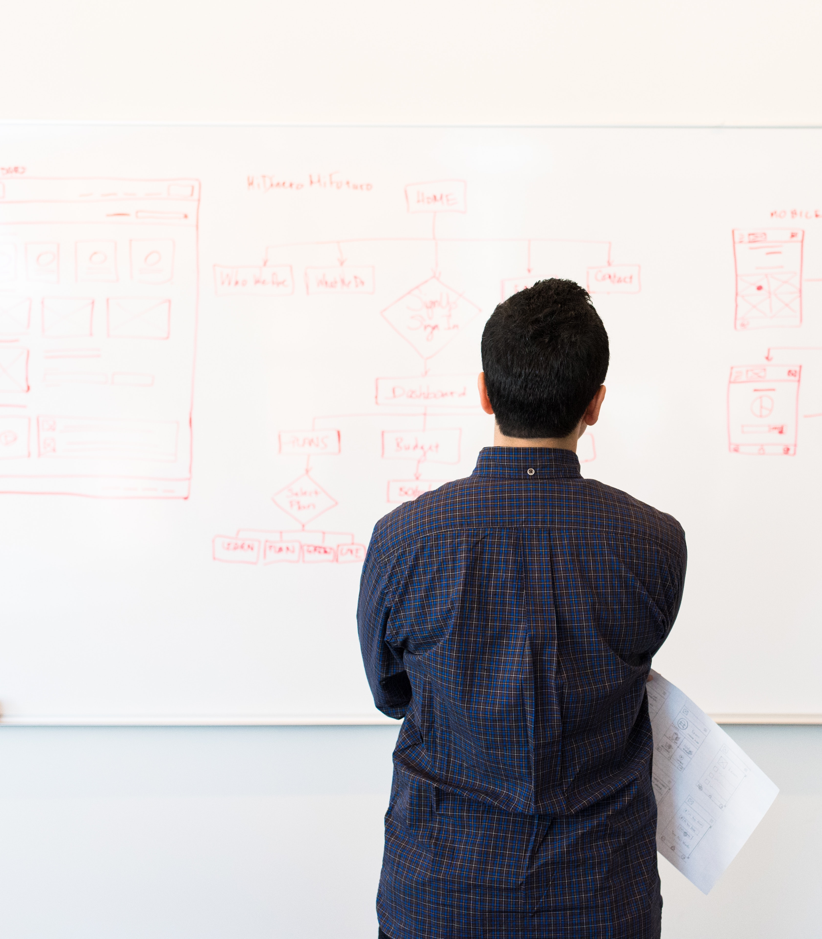
Concept
(Eye tracking) Software that gives people with severe disabilities and low mobility back some independence by making it possible to control home automation devices (turning on lights, opening doors, controlling heating) with their eyes or face gestures.

Slide 5
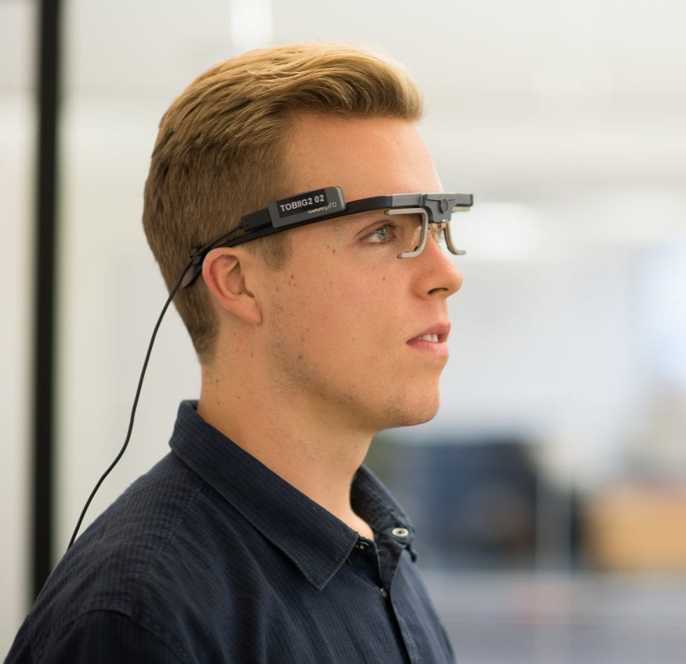
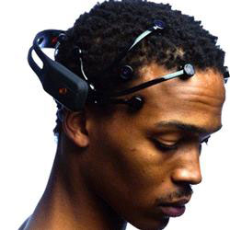
Input
Eye tracking/Face Tracking - Kinect or cameras
Neural Headset – NextMind

Slide 6
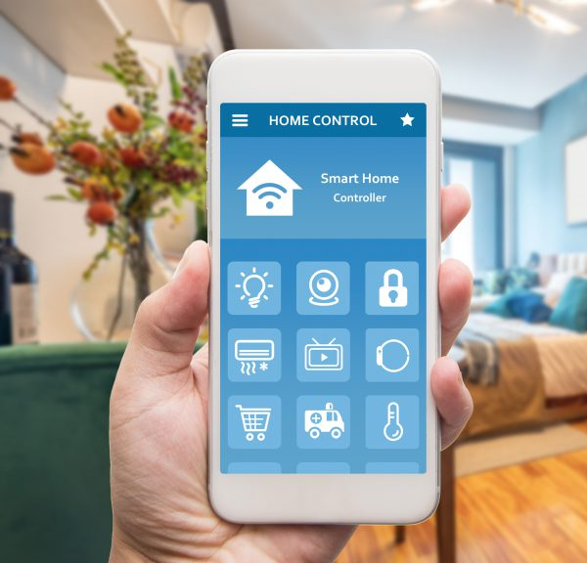
Output
Home automation
Micro Controller
Research target group

Slide 7

Thank you for listening

